Slide 1
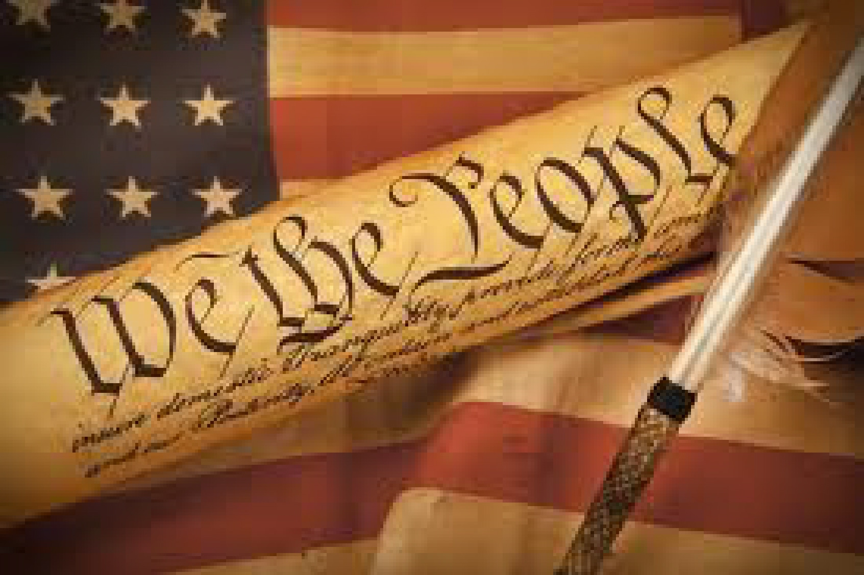
TODAY
Complete 1 minute current event presentations (1-2 max)
Discuss American Constitution
Discuss 3 Branches
How does this translate to class?
Hand Back & Discuss Assessment

Slide 3
WHAT IS THE US CONSTITUTION?
Supreme law of the state
The foundation and source of the legal authority underlying the existence of the USA and Government of the US.
Provides framework for the organization of the US Government

Slide 4
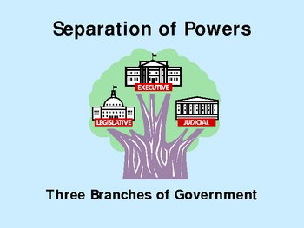
Basic Principals
Popular Sovereignty
POWER RESIDES IN THE PEOPLE
Limited Government
Government not all powerful.
Can only do what the people let it.
Separation of Powers
Helps prevent one branch from becoming too powerful
Checks and Balances

Slide 5
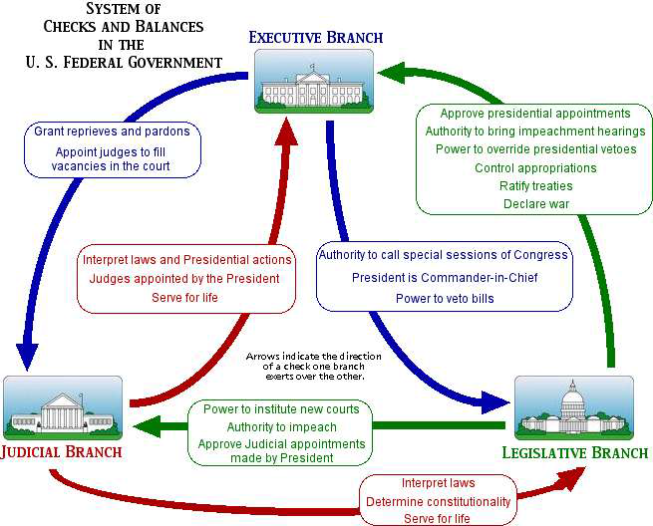

Slide 6
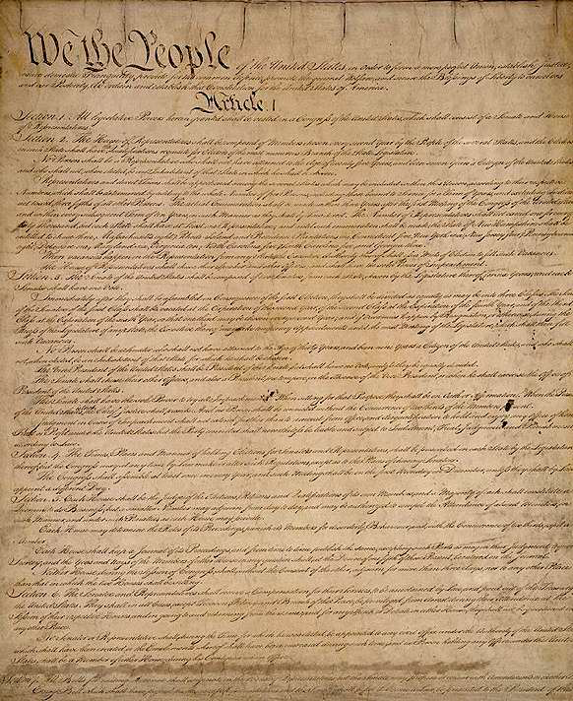
STRUCTURE OF CONSTITUTION
PREAMBLE
Statement of purpose
Articles:
1-Legislative Branch
2-Executive Branch
3-Judicial Branch
5-Amendment Process
7-Ratification of laws
Amendments:
27 total
1st 10 are the BILL OF RIGHTS
Notes:
Missing: 4 – Relations Among States
6 – Federal Power
AFTER THIS WATCH HISTORY CHANEL VIDEO ON CONSTITUTION (3 Mins)

Slide 7
PREAMBLE CHALLENGE:
Friday: We will be talking about our values and our goals as a class.
For 3points on your assessment (4%)
You are challenged to write and submit a preamble that states the purpose of our constitution. It will be voted on by all citizens (including Mr. M)

Slide 8
Article 1 – Legislative Branch
Structure: Bicameral
House of Representatives
Based on population
Senate
2 Senators for each state
REPS SERVE 2 YEAR TERMS
SENATORS SERVE FOR 6 YEAR TERMS
IMPORTANT POWERS
Make laws
Set taxes
Declare war
Override Vetoes
Borrow money
Regulate international & national trade
Print money
Notes:
Missing: 4 – Relations Among States
6 – Federal Power

Slide 9
Article 2 – Executive Branch
President and VP elected to 4 year term
Qualifications:
35 years old
14 year resident of US
Natural born citizen
(Elected by Electoral College)
IMPORTANT POWERS
Commander-in-Chief
Grant pardons
Make treaties
Appoint federal officers
Ensure laws are executed
Notes:
Missing: 4 – Relations Among States
6 – Federal Power

Slide 10
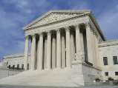
Article 3 – Judicial Branch
Supreme Court judges serve for life unless impeached.
Judicial power rests with US Supreme Court and other courts created by Congress.
IMPORTANT POWERS
Decides cases of Constitutional law and federal law
Cases involving ambassadors go straight to Supreme Court
Notes:
Missing: 4 – Relations Among States
6 – Federal Power

Slide 11
OTHER IMPORTANT ARTICLES
Article 5: Amendments
Amendments proposed if 2/3 of House and Senate deem necessary (or States)
Ratified (passed) by 3/4th of states (or conventions in 3/4th of state)
QUESTION
HOW WILL WE MAKE CHANGES TO THE CONSTITUTION LATER?
Notes:
Missing: 4 – Relations Among States
6 – Federal Power

Slide 12
BILL OF RIGHTS
Freedom of religion, of speech, of the press, to assemble, and to petition.
Right to bear arms
No quartering of soldiers
No unreasonable search and seizure
Indictments; Due process; Self-incrimination; Double jeopardy, and rules for Eminent Domain.
Right to a fair and speedy public trial, Notice of accusations, Confronting one’s accuser, Subpoenas, Right to counsel
Right to trial by jury in civil cases
No excessive bail & fines or cruel & unusual punishment
Notes:
13th – Abolished Slavery
14th – All people born here are citizens here – Equal protection
15th – Right to vote regardless of race color etc.
22nd – Term limits
26th – Voting to 18

Slide 13
In Pairs – BRAIN STORM
What should the structures look like in our class?
What should their roles/functions be? (Remember, we are in an academic setting)
Restriction on length of terms? Qualifications? If students miss HW or do not pull their weight, should they lose their rights?
How will the state make sure we accomplish the standards set by WASC (to make sure Mr. M does not lose his job)?
How will policy be created? How will we create goals and direction for future terms?
Notes:
13th – Abolished Slavery
14th – All people born here are citizens here – Equal protection
15th – Right to vote regardless of race color etc.
22nd – Term limits
26th – Voting to 18

